Slide 1

Lean development
Sudeep Lal Bajimaya

Slide 2
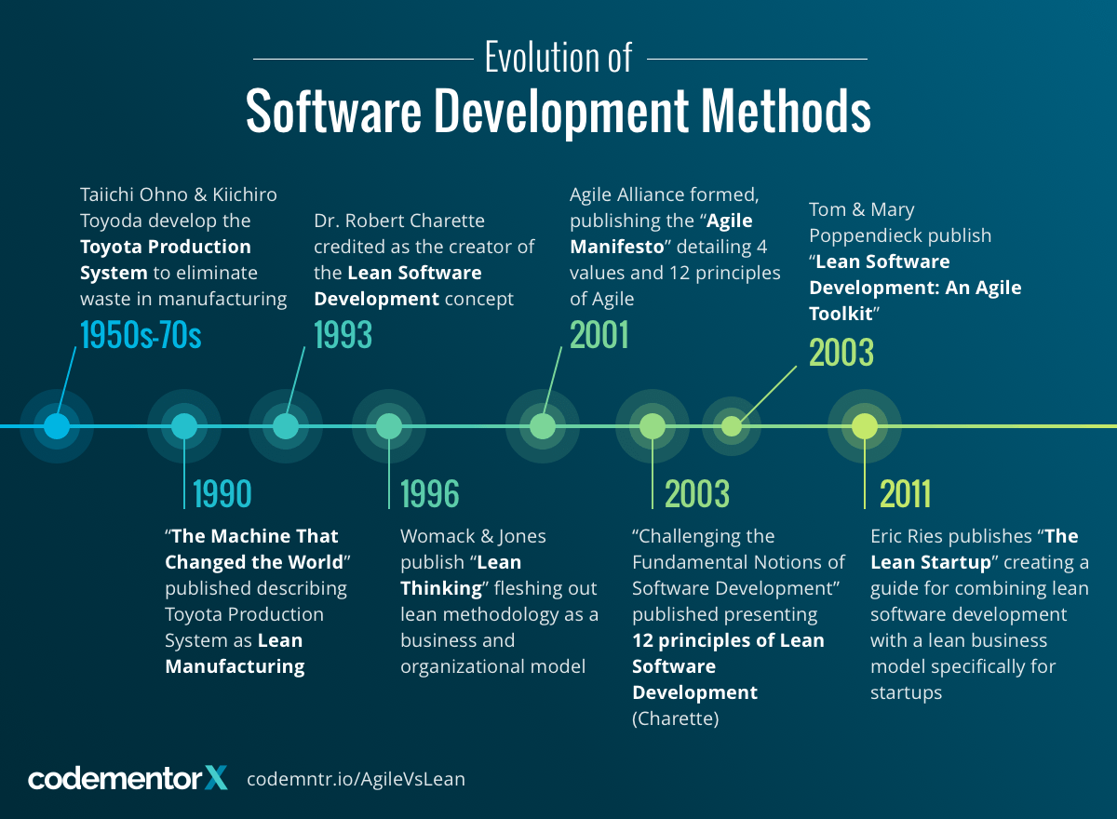

Slide 3
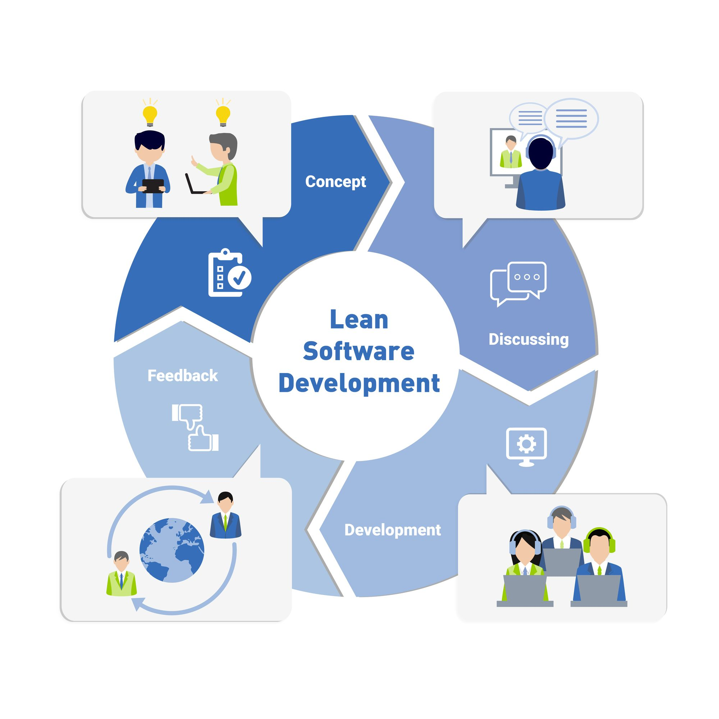

Slide 4
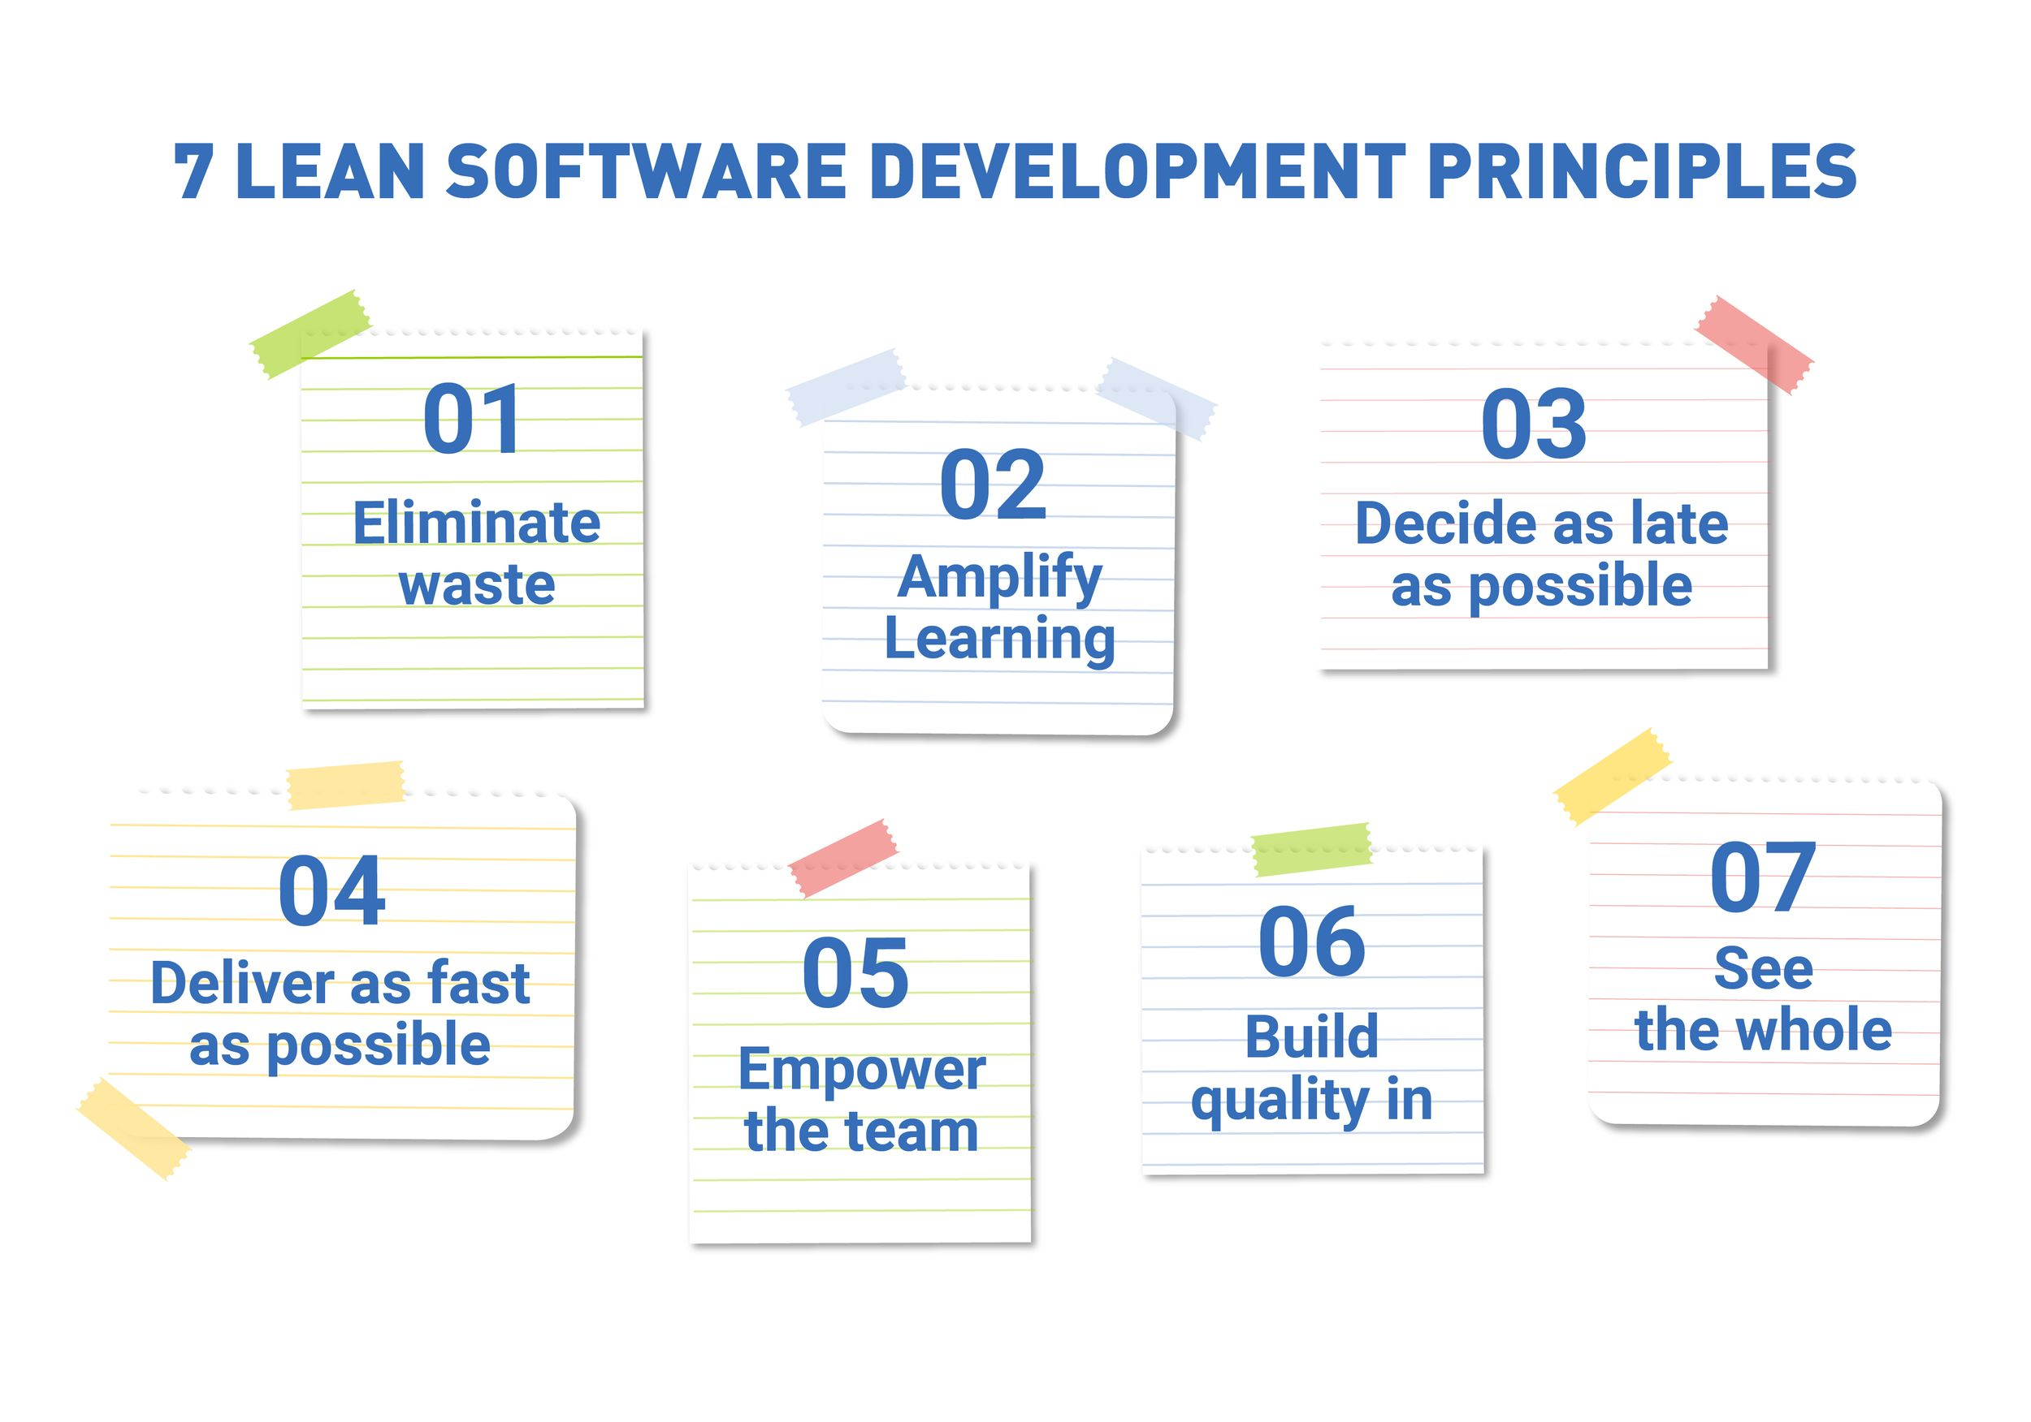

Slide 5
(Lean=Agile) ?

Slide 6
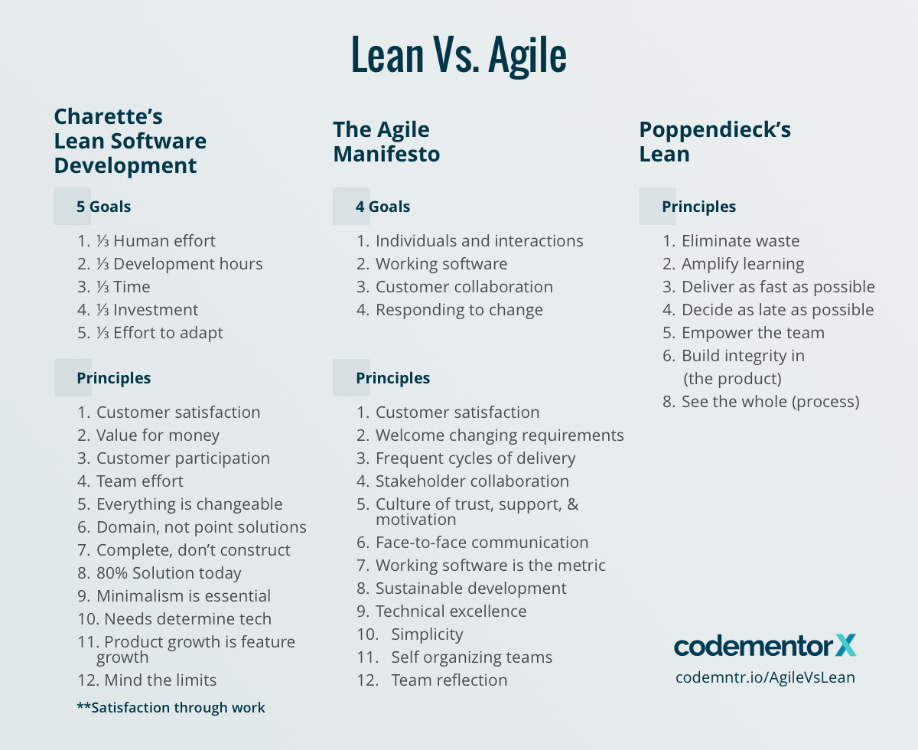

Slide 7
1. Eliminate waste
Definition of waste:
Waste: Anything that does not deliver the value is considered as waste.
Waste is an intrinsic part of a system; some types of waste are a result of beneficial aspects of your process.
Seven types of waste
Work in progress
Over-engineering
Hand offs
Task switching
Delays
Relearning the process
Defects

Slide 8
2. Amplify Learning
Learn during development (add more value to learning during development)
Through feedbacks
Through deliverables

Slide 9
3. Deliver as fast as possible
Reduce waste
Learn from deliverables

Slide 10
4. Decide as late as possible
Sometime deciding late is good.
Helps to eliminate waste
Increase value

Slide 11
5. Empower the team
Educate the team about the project

Slide 12
6. Build integrity in
free from flaw, defect, and decay.

Slide 13
7. See the whole
A system is not just the sum of its parts - it is the product of their interactions.
The best parts do not necessarily make the best system.
The ability of a system to achieve its purpose depends on how well the parts work together, not just how well they perform individually.

Slide 14
Comparison
The Waste of Overproduction.
The waste of overproduction is one of the biggest reasons the Waterfall method has been abandoned. Overproduction is considered extra coding for features that weren’t requested and that the customer may not want.
This is reflected in the following principles:
Agile ⟶ simplicity
Charette’s Lean⟶ minimalism
Poppendiecks’ Lean ⟶ eliminate waste

Slide 15
The Waste of Waiting.
In JIT manufacturing, waiting on an idle machine or worker is wasteful. In software development, waste is waiting on a team with excess capacity. If there are delays in production that cause a team to be on standby, or cause the customer to wait for delivery, there is waste.
Matching principles are as follows:
Agile ⟶ frequent cycles
Charette’s Lean ⟶ ⅓ of the time (goal of LSD), 80% solution today
Poppendieck’s Lean⟶ deliver as fast as possible

Slide 16
The Waste of Transportation.
In software development, transportation is translated as “task switching”. Too many handovers or employees assigned to multiple teams with a demand for excessive multitasking is inefficient and a waste.
Matching principles:
Agile ⟶ stakeholder collaboration, self-organizing teams
Charette’s Lean ⟶ team effort
Poppendiecks’ Lean ⟶ empower the team

Slide 17
The Waste of Over processing.
This is simply extra processes that aren’t really needed to deliver value to the customer. The primary example is documentation. Excessive documentation for inflexible processes will not be valuable, nor are overly detailed user manuals which could be summed up in a page or two. Documentation is time-consuming yet offers limited value to the end-user.
Matching principles:
Agile ⟶ simplicity, working software as the measure
Charette’s Lean ⟶ minimalism
Poppendiecks’ Lean ⟶ eliminate waste

Slide 18
The Waste of Inventory.
Inventory waste is Work-in-Progress for which an investment has been made, but holds no value until completion. In other words, incomplete software provides no value to the user. Lean and Agile value fast and frequent deliveries, with an emphasis on frequent iterative cycles and delivery of working software.
Matching principles:
Agile ⟶ customer satisfaction (through early and frequent customer delivery)
Charette’s Lean ⟶ 80% solution today
Poppendieck’s Lean ⟶ deliver as fast as possible

Slide 19
The Waste of Movement.
Waste of movement is excess effort required to get information or answer questions. This is common when teams are not co-located, if tasks are completed and results are not made available immediately to all relevant parties, or when stakeholders are not readily available for consultation.
Matching principles:
Agile ⟶ stakeholder collaboration, face-to-face communication
Charette’s Lean ⟶ customer participation, team effort
Poppendiecks’ Lean ⟶ eliminate waste

Slide 20
The Waste of Defects.
Like in manufacturing, producing defective or buggy software represents a wasted investment by the company. The quicker a defect is detected; the more likely waste is mitigated. Many Agile and Lean principles seek to halt the waste of defects. To reduce defects, all three methodologies place a premium on early and frequent testing.
Matching principles:
Agile ⟶ technical excellence, working software as a measure
Charette’s Lean ⟶ customer satisfaction
Poppendiecks’ Lean⟶ amplify learning

Slide 21
The Waste of Unused Employee Creativity.
In software development, unused creativity results from a rigid roadmap and lack of human collaboration. Just like Jidoka (自働化), Agile and Lean seek to maximize human cooperation and innovation to get the best results out of technology.
Matching principles:
Agile ⟶ stakeholder collaboration, team reflection
Charette’s Lean ⟶ “unwritten” 13th principle of satisfaction through work
Poppendiecks’ Lean ⟶ amplify learning

Slide 22
Reference and bibliography
Mary Poppendieck, Tom Poppendieck. Lean Software Development: An Agile Toolkit
https://www.codementor.io/blog/software-development-methodologies-lean-vs-agile-principles-2fdodzuyzy

